Slide 1
Java Syntax
public class Main {
public static void main(String[] args) {
System.out.println("Hello World");
}
}

Slide 2
Java Comments
// This is the single line comment
/* This is the multiple line comment */

Slide 3
Java Variables
Declaring (Creating) Variables
To create a variable, you must specify the type and assign it a value:
Syntax
type variable = value;

Slide 4
Final Variables
However, you can add the final keyword if you don't want others (or yourself) to overwrite existing values (this will declare the variable as "final" or "constant", which means unchangeable and read-only):
Example
final int myNum = 15;
myNum = 20; // will generate an error: cannot assign a value to a final variable

Slide 5
Other Types
A demonstration of how to declare variables of other types:
Example
int myNum = 5;
float myFloatNum = 5.99f;
char myLetter = 'D';
boolean myBool = true;
String myText = "Hello";

Slide 6
Display Variables
The println() method is often used to display variables.
To combine both text and a variable, use the + character:
Example
String name = "John";
System.out.println("Hello " + name);

Slide 7
Declare Many Variables
To declare more than one variable of the same type, use a comma-separated list:
Example
int x = 5, y = 6, z = 50;
System.out.println(x + y + z);

Slide 8
Java Identifiers
All Java variables must be identified with unique names.
These unique names are called identifiers.
Identifiers can be short names (like x and y) or more descriptive names (age, sum, totalVolume).
Note: It is recommended to use descriptive names in order to create understandable and maintainable code:
Example
// Good
int minutesPerHour = 60;
// OK, but not so easy to understand what m actually is
int m = 60;

Slide 9
FINALLY
The general rules for constructing names for variables (unique identifiers) are:
Names can contain letters, digits, underscores, and dollar signs
Names must begin with a letter
Names should start with a lowercase letter and it cannot contain whitespace
Names can also begin with $ and _ (but we will not use it in this tutorial)
Names are case sensitive ("myVar" and "myvar" are different variables)
Reserved words (like Java keywords, such as int or boolean) cannot be used as names

Slide 10
Java Operators
Operators are used to perform operations on variables and values.
In the example below, we use the + operator to add together two values:
Example
int x = 100 + 50;

Slide 11
int sum1 = 100 + 50; // 150 (100 + 50)
int sum2 = sum1 + 250; // 400 (150 + 250)
int sum3 = sum2 + sum2; // 800 (400 + 400)

Slide 12
Java divides the operators into the following groups:
Arithmetic operators
Assignment operators
Comparison operators
Logical operators
Bitwise operators

Slide 13
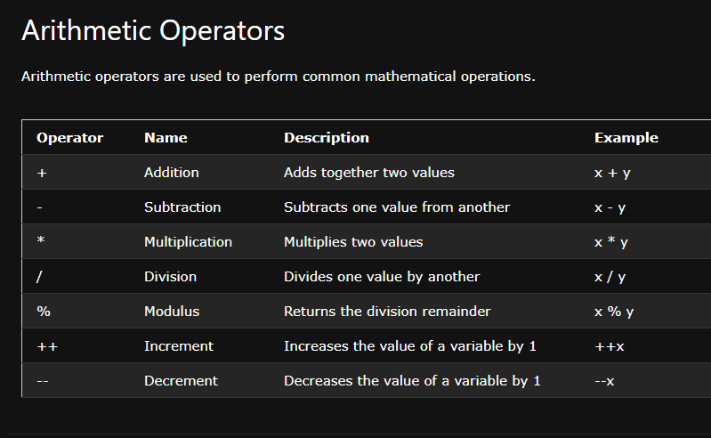

Slide 14
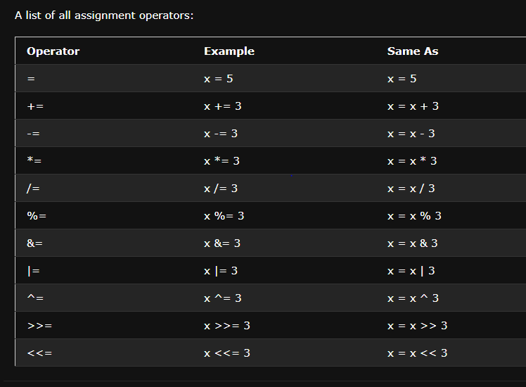

Slide 15
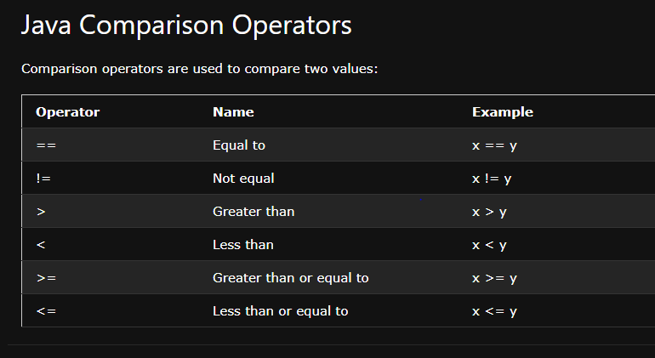

Slide 16
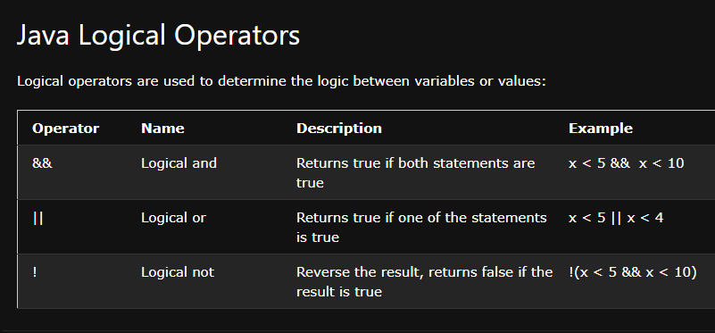

Slide 17
